Slide 1
Progress updates
O Hwang Kwon
Notes:
Today, I just wanted to briefly discuss about the current status of the research.
Thanks for giving me time.

Slide 2
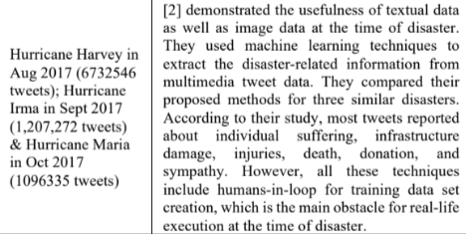
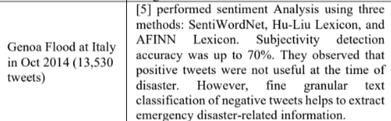
Current Status – Mining Tweets
Current Status – Data mining (3,000 Nuclear tweets collected)
More than 3,000 nuclear tweets are collected from twitter.
Benchmarking the literature, at least 10,000 tweets are required for the research.
Source : Aparup Kahtua, Eric Cambria ‘Deciphering public opinion of nuclear energy on twitter)’
* Current Twitter API subscription allows us to obtain 10k tweets a month.
Used 1.2m tweets
Used 13,530 tweets
Notes:
First of all, I am collecting the tweets using API.
Currently, I collected around 3,000 tweets.
This has been delayed because I can only scrape 100 tweets at once.
But I think I can collect more than 5,000 tweets before Thursday.
Based on the literature, it seems like that ten thousand tweets are the minimum baseline for the analysis.
I am now reviewing the quality of the tweets. It seems like because of the Ukraine war and Presidential election, nuclear tweets related to politics are prevailing.
With that being said, I am trying to refine those irrelevant tweets using appropriate queries.
Plus, I found that related research balanced the number of positive tweets and the negative tweets.
But for now, my conclusion is the more, the better.

Slide 3
Current Status – Data Labeling
Current Status – Data Labeling
Data labeling is one of the most arduous jobs in ML process.
Industries usually hire people to label the data.
Doccano is a good software that we can utilize for data labeling management, but it seems like that we cannot automatically label all the data using python API.
VADER and TextBlob are not reliable.
Notes:
And this is the most arduous job on our project. Data lableing.
I searched for business columns and research papers.
However, manual labeling is the most reliable way of labeling.
Even industries just hire people for data lableing.
As we discussed earlier, Doccano, VADER and Textblob seem not promising enough.

Slide 4
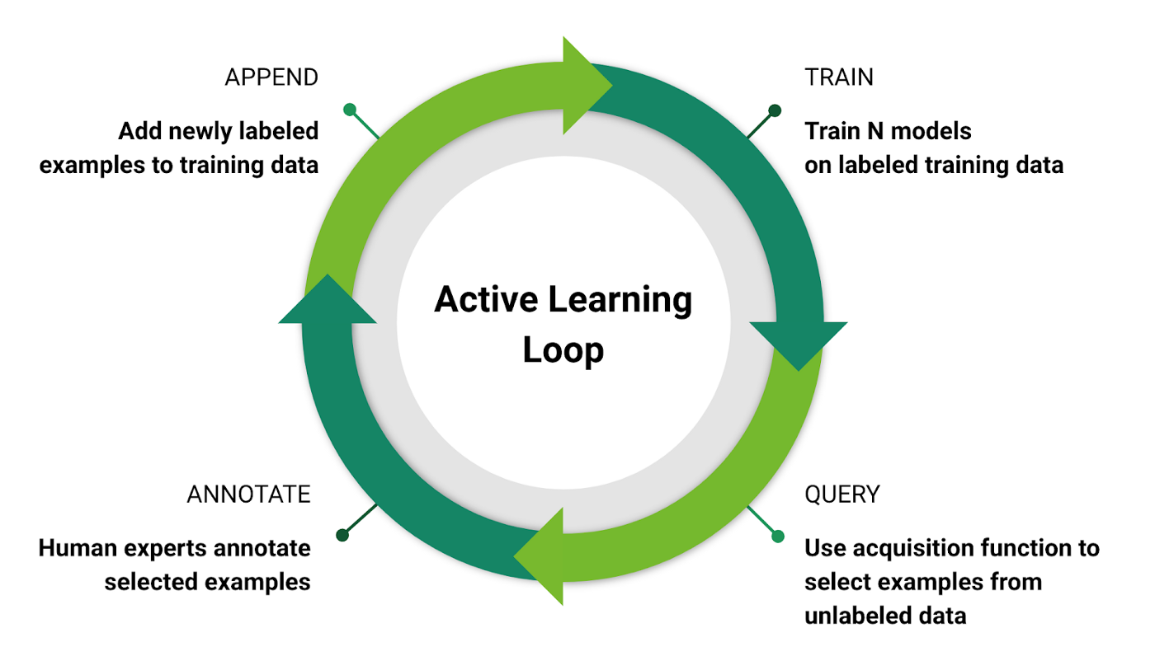
Possible Solution – Active Learning Process
Idea
Active learning is a semi-supervised learning approach in machine learning where an algorithm actively selects which data samples to label in order to achieve better model performance with less labeled data.
Notes:
A few days ago I found some companies are utilizing active learning process in ML.
The idea of active learning is that the machine actively selects which data samples to label in order to achieve better model performance with less labeled data.
This process is attractive in that we can achieve the performance with less amount of manually labeled data.
Initially, in the active learning process, a small set of labeled data is available. This labeled data is used to train the initial model. Once the model is trained, it can make predictions on the unlabeled data.
The key difference in active learning is that instead of randomly selecting instances for labeling, the model actively chooses which unlabeled instances it wants the person to label. The model selects instances that it finds most informative, uncertain, or challenging. These selected instances are then sent to the person for labeling.
After receiving the labels from the oracle, the newly labeled instances are incorporated into the training set, along with the initially labeled data. The model is then retrained on the updated labeled dataset. This iterative process continues, with the model continuously selecting informative instances, querying the oracle for labels, and updating the model.
Through this iterative process, the model learns to improve its predictions by actively selecting and incorporating labeled data that provides the most valuable information for its learning process. While the model participates in the selection of instances, it still relies on the labeled data to learn and make predictions. Thus, active learning is a form of supervised learning, where the model is guided by its own selection process to improve its performance.

Slide 5
Possible Solution – Active Learning Process
Possible selection algorithm
Entropy
Least confidence
Margin Sampling
Notes:
This slide is about how the model selects the data.
Entropy approach measures the uncertainty of a random variable. This allows the system to use all possible label probabilities. The instance with the highest entropy value is required.
Least confidence – Using this approach, the active learning model chooses data that doesn’t meet the confidence threshold. For example, if the model isn’t 99.9% certain what a particular object is, it will initiate a query for further analysis.
Margin sampling – This approach helps correct shortcomings in the least-confidence strategy by incorporating the second-most likely label for the data. This gives the model the chance to differentiate between the two most-likely labels.

Slide 6
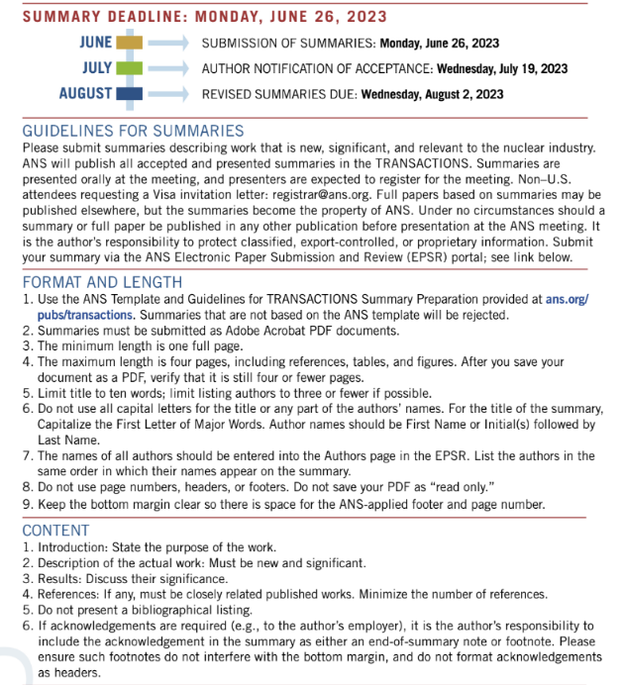
ANS Winter Meeting
Call for summaries – June 26th
Notes:
I just want to notify the call for summaries for ANS winter meeting is due to June 26th.
Maybe we can prepare for the summaries, and then see the progress whether we can present something until the winter meeting.

